Slide 1
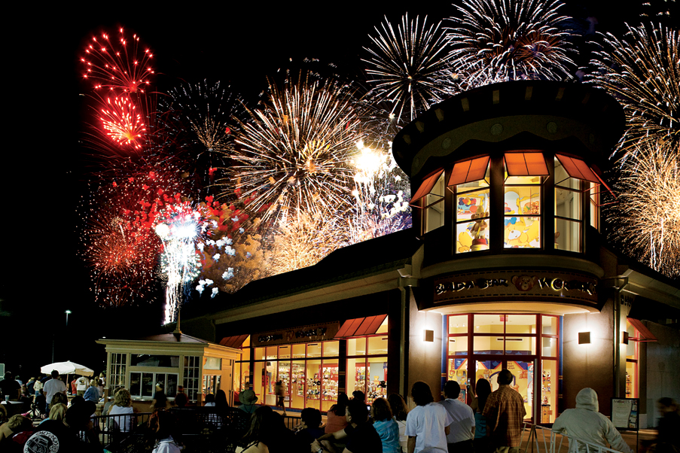
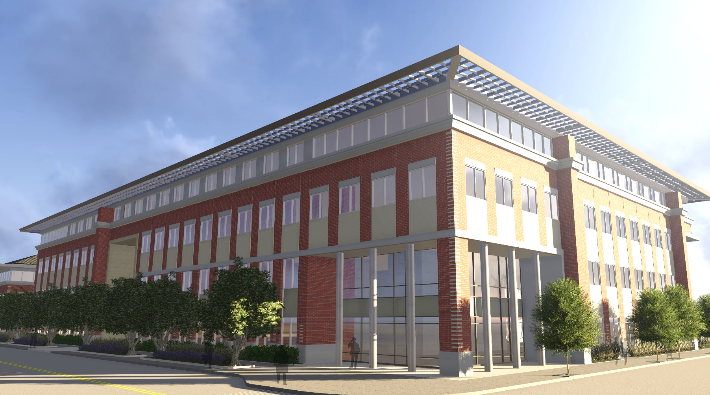
All information provided is confidential, conceptual, for discussion and/or illustrative purposes only, and subject to change by McWhinney Real Estate Services, Inc. or its affiliates without notice. Financial information, expenses, and projections include estimates, assumptions, and forward looking statements which may not prove to be correct and which involve risks. Plans, specifications, amenities, features, availability, amounts, prices, and other elements are also subject to change. All information is provided without representation or warranty, and may not be relied upon for any purpose.
David Crowder, GM of Centerra | January 26, 2016

Slide 2
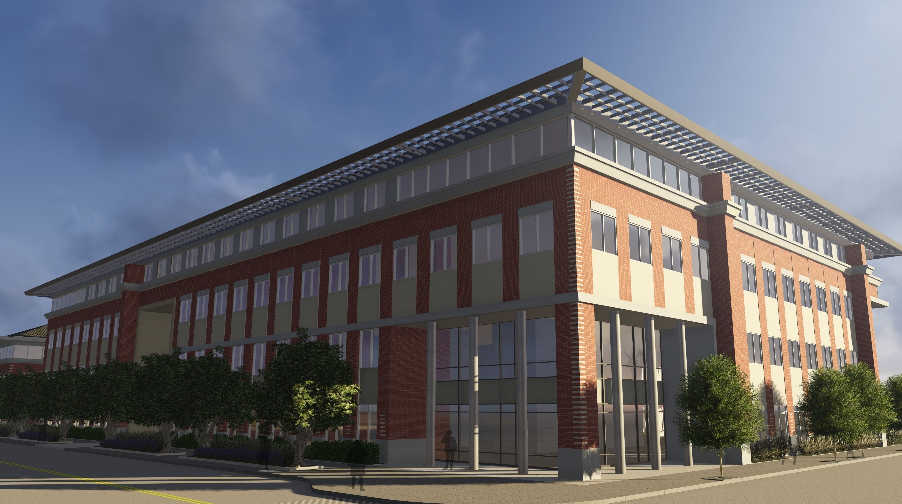
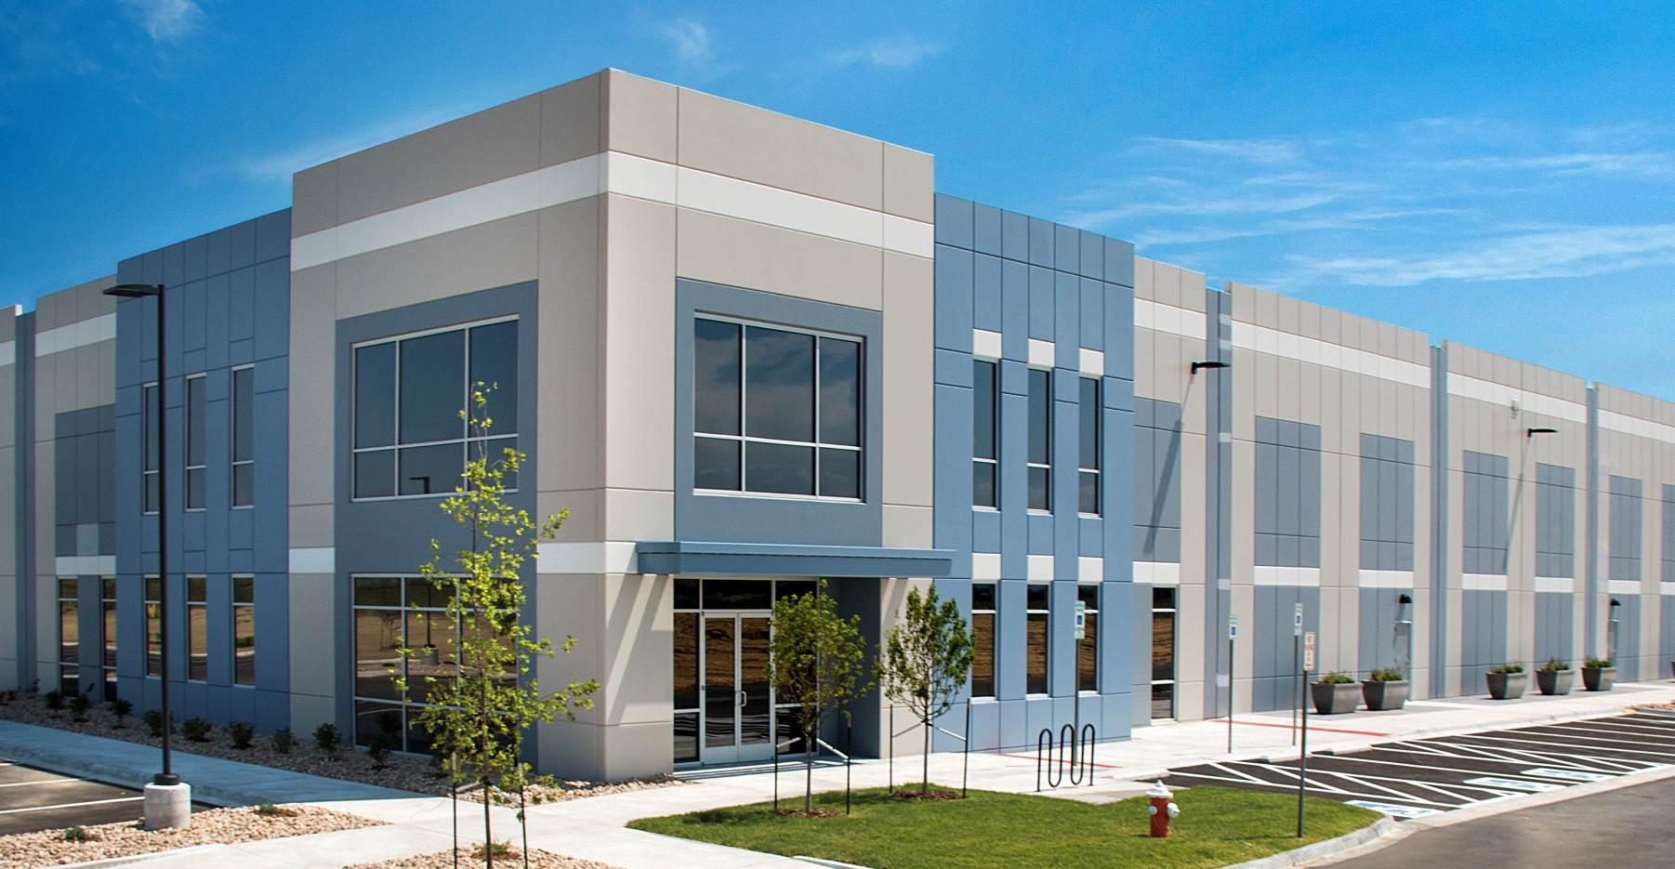
Active Projects Include:
Recently completed Hahn’s Peak II (56k SF Class A)
Agrium US Headquarters on Parcel 206 – 1,200 employees at completion (122k SF Class A) and supporting infrastructure
The Lakes Residential MPC (approx. 800-1000 homes)
Centerra Industrial I (84k SF)
Main Street Skilled Nursing (60k SF on 4.9 acres)
The Flats at Centerra Condos
HPEC Headquarters – Visitor Center
EDUCATED WORKFORCE • SPIRIT OF INNOVATION • TENANT RETENTION LEADING MEDICAL SERVICES • CLASS A • FLEXIBLE SPACE
All information provided is confidential, conceptual, for discussion and/or illustrative purposes only, and subject to change by McWhinney Real Estate Services, Inc. or its affiliates without notice. Financial information, expenses, and projections include estimates, assumptions, and forward looking statements which may not prove to be correct and which involve risks. Plans, specifications, amenities, features, availability, amounts, prices, and other elements are also subject to change. All information is provided without representation or warranty, and may not be relied upon for any purpose.

Slide 3
Upcoming:
Mixed Use Development at Parcel 206
420 apartments and Mixed Use Development on Parcels 504
3 hotels on Parcel 505
Expansion of Centerra Industrial
TOD at Kendall and I-25
East Side Residential MPC
CDOT Widening of Crossroads, I-25 Widening and Kendall Parkway Underpass by 2020
EDUCATED WORKFORCE • SPIRIT OF INNOVATION • TENANT RETENTION LEADING MEDICAL SERVICES • CLASS A • FLEXIBLE SPACE
All information provided is confidential, conceptual, for discussion and/or illustrative purposes only, and subject to change by McWhinney Real Estate Services, Inc. or its affiliates without notice. Financial information, expenses, and projections include estimates, assumptions, and forward looking statements which may not prove to be correct and which involve risks. Plans, specifications, amenities, features, availability, amounts, prices, and other elements are also subject to change. All information is provided without representation or warranty, and may not be relied upon for any purpose.

Slide 4
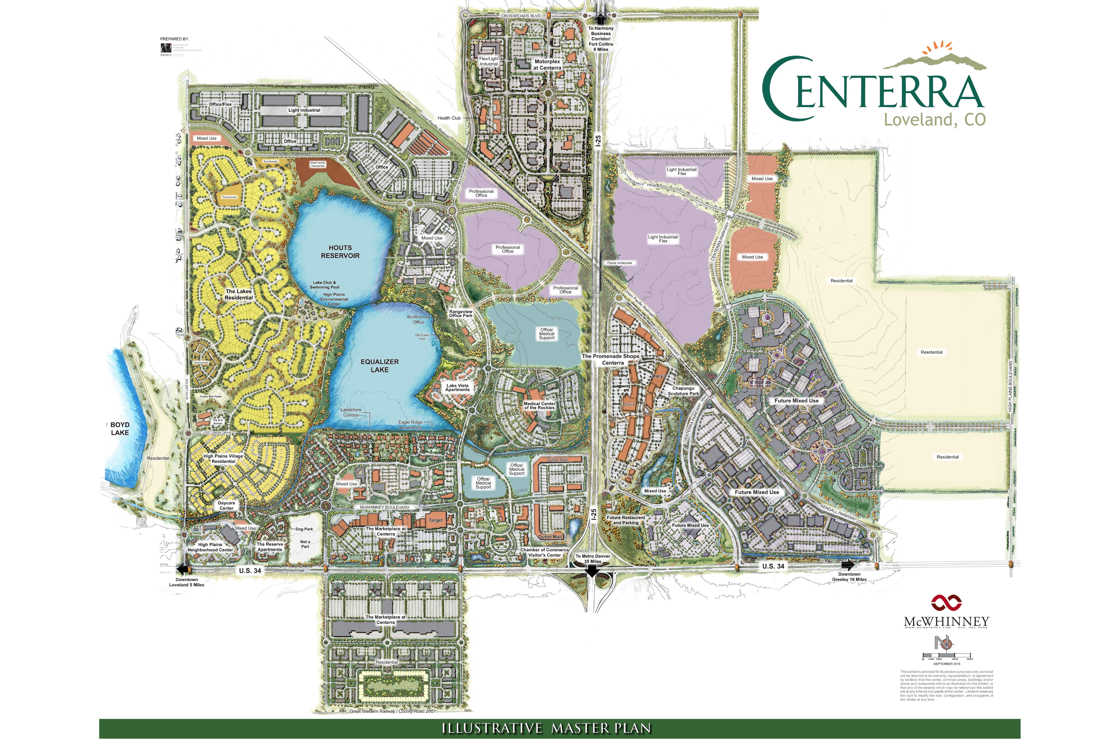
Parcel 505
3 Hotels will begin in 2017
Restaurant Pads Available in late 2017/early 2018
Planning for an Additional Full Service Hotel/Retail/Entertainment

Slide 5
I-25 Project
I-25 Project
CDOT’s I-25 Widening Project and TOD Development:
Beginning in late 2017 – 3 years to complete
Widening Crossroads undercrossing to 4-lanes
Widening I-25 to 3-lanes in each direction
Construction of Kendall undercrossing
Bus Rapid Transit (BRT) Station at Kendall/I-25
TOD – Transit Oriented Development to Leverage BRT

Slide 6
Eastside MPC
2,500 to 3,000 homes
2 to 3 villages
Multi-gen Offerings
Strong Ties to Retail and Mixed Use
Est Start 2019

Slide 7
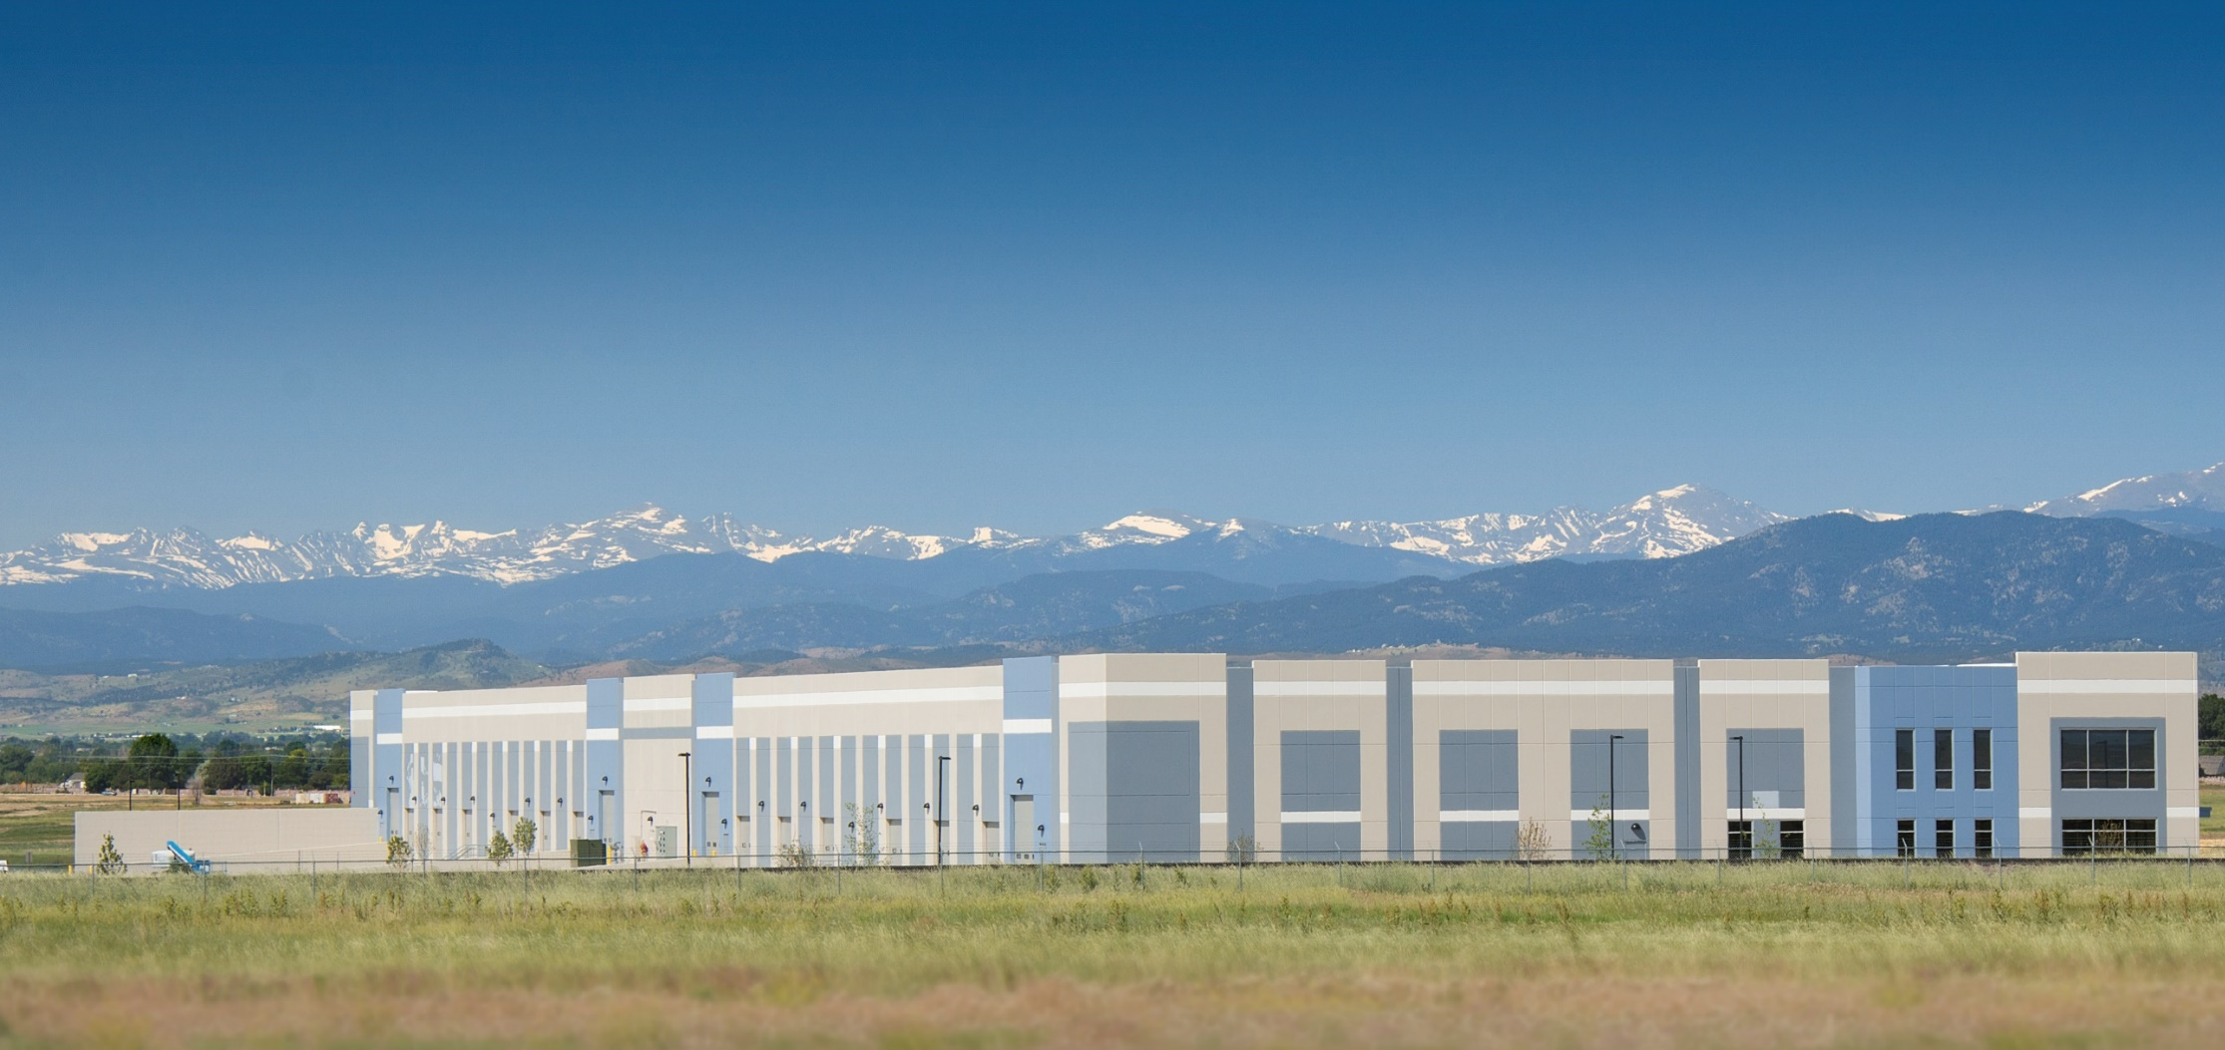
Centerra Industrial
Centerra Industrial / Logistics Hub
Industrial I Building 100% leased!!
6-7 Buildings total
Just announced 84k SF Industrial II building
Ranging from 86k to 170k SF
Designed to Meet Demand for e-commerce and Logistics Industries

